Slide 1
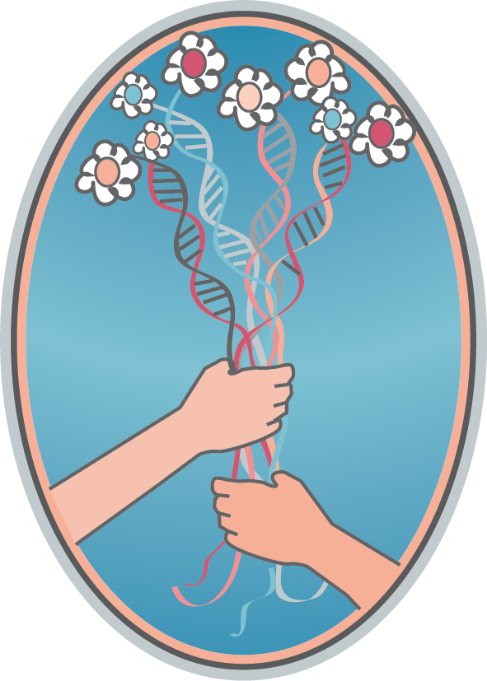
The Donor Conceived Adult
Implications Within Family, Medical
and Mental Healthcare Systems
WENDY KRAMER
DONOR SIBLING REGISTRY
Original paper by Hilary Bertish, PhD, and Wendy Kramer

Slide 2
Numbers Growing
In today’s society where women more often have children later in life, same-sex and single-parent families are more prevalent, and infertility is less stigmatized than in the past, alternative methods to creating families, including the use of donors and embryo adoptions, is increasing exponentially.
Single mothers by choice: 50%
LGBTQ: 33%
Infertile couples: 17%
Notes:
The majority of the children of the 108 Egg Donor Parents and many of the 1700 sperm donor recipients are too young to have expressed curiosity yet and still the great majority of all offspring wish to be in contact with their donors and half siblings and recommend that parents use open or willing-to-be known donors.
Offspring of single heterosexual parents and LGBT parents learn about the method of their conception at an earlier age and are therefore more comfortable expressing curiosity about the donor with their parents than offspring of 2 heterosexual parents.

Slide 3
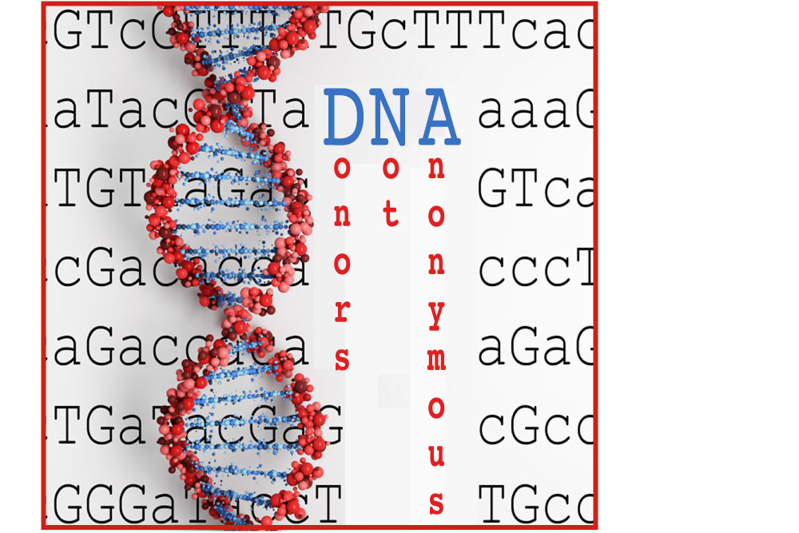
The Ambiguity of “Open” Donors
All sperm and egg donors are still sold as "anonymous", even if only for 18 years. US banks and clinics with “open” donors, sometimes connect offspring with donors at age 18, but there are no guarantees.
Many who are promised this contact are devastated when it doesn’t happen.
Notes:
Sperm banks never reply to requests, or claim that donors are unreachable or change their minds.

Slide 4
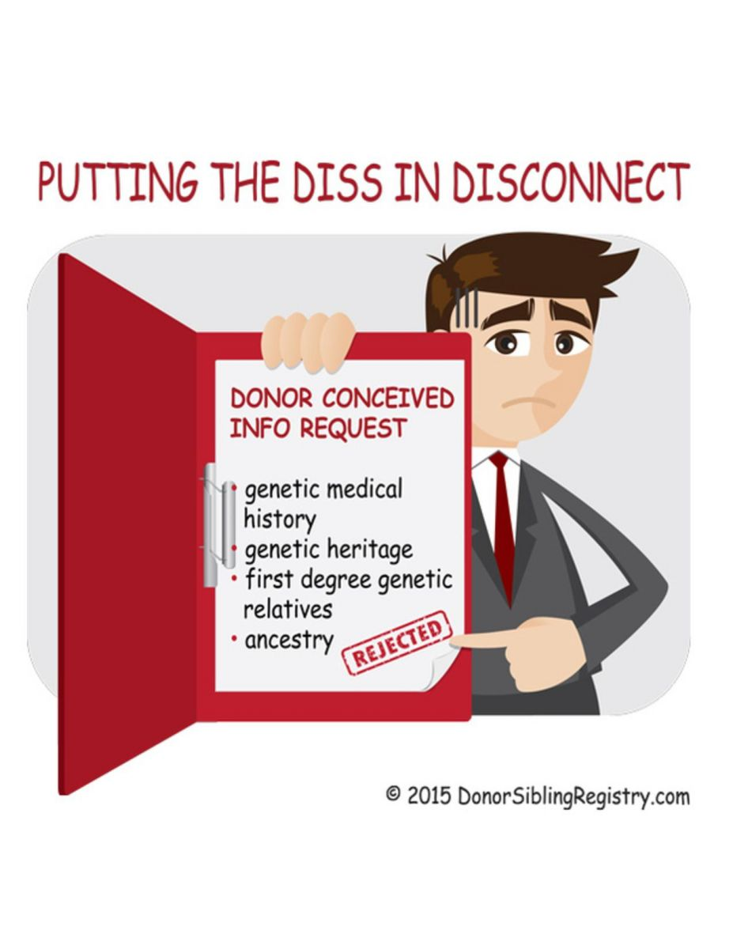
The Rights of ALL Stakeholders
For decades it’s been about the rights of all these stakeholders:
1. The rights of parents to have a child;
2. The rights of donors to sell their gametes
and to be anonymous;
3. The rights of the sperm banks and
egg clinics to sell gametes.
But not about the rights of these:
Donor offspring.
They should not only be included in the conversation, but be at the forefront of it.
Notes:
The focus: “reproductive rights”. What about the needs and rights of donor
offspring to know about their ancestry,
medical backgrounds, and close genetic relatives?

Slide 5
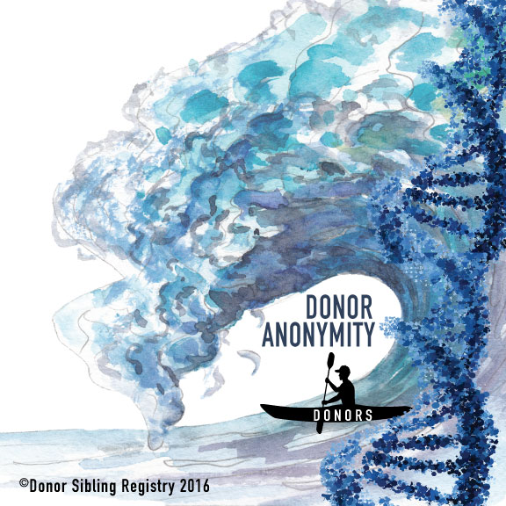
DNA= Donors Not Anonymous
Donors who do not wish to be found just shouldn’t donate.
If you have been in contact with your donor, how did you find him/her?
Offspring with Heterosexual parents:
DSR: 17.21%
DNA: 42.48%
Offspring in LGBT families:
DSR: 29.89%
DNA: 14.94%
The DSR, DNA, social media, public
Record searches and Google have all
contributed to the end of anonymity.
Notes:
In a recent survey of 2,103 donor-conceived people we asked:

Slide 6
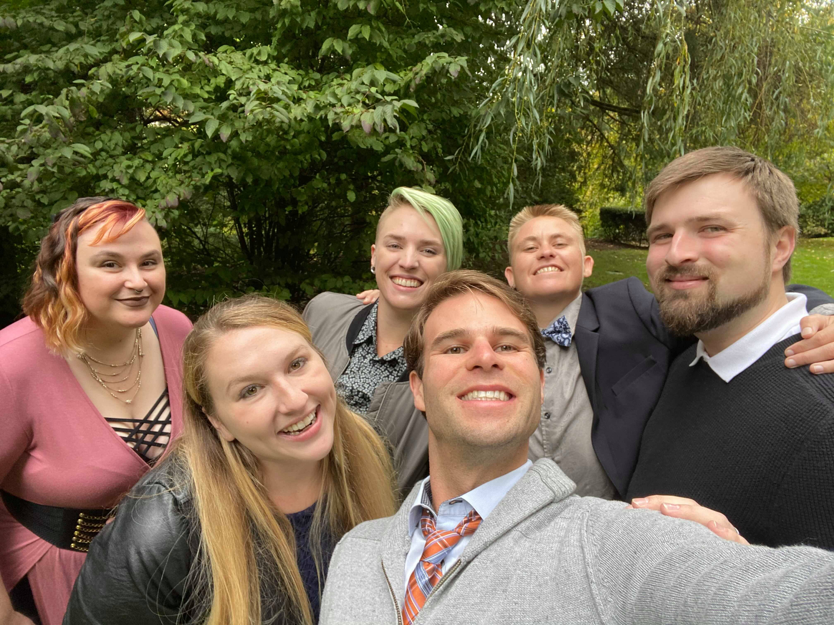
Understanding the needs and issues of donor-conceived (DC) adults across healthcare systems is critical
Previously, adoption and donor conception were kept secret from the offspring.
30 million now have submitted DNA to Ancestry and 23andme.
large numbers of individuals are discovering for the first time as adults that they were donor-conceived.
donor offspring are increasingly likely to present to mental health professionals for this or other unrelated issues.
an understanding of the DC adult, particularly within the context of the family, the treatment, and across healthcare systems is critical.

Slide 7
Outdated Advice: Secrecy
More current research:
Preverbal disclosure is recommended.
Late discovery [teen or adult] adoptees and donor-conceived people report feelings of betrayal, loss of trust, and difficulty forgiving in relation to the late discovery experience.
Clinicians should therefore be prepared to work with these themes and associated distress in treatment.
Such work also delves into the systemic nature of family secrets, and how clarifying these dynamics within a particular family can assist in the therapeutic process.
Previous recommendations in adoption:
It was critical not to tell individuals of their status “until after they had progressed beyond the challenges of childhood”, due to the belief that psychological distress was caused by the disclosure of adoption.
Notes:
Donors can define these connections in many ways. From becoming a “dad” to a simple anonymous exchange of medical information.
And, it’s not just about the donor, it’s about his family too.

Slide 8
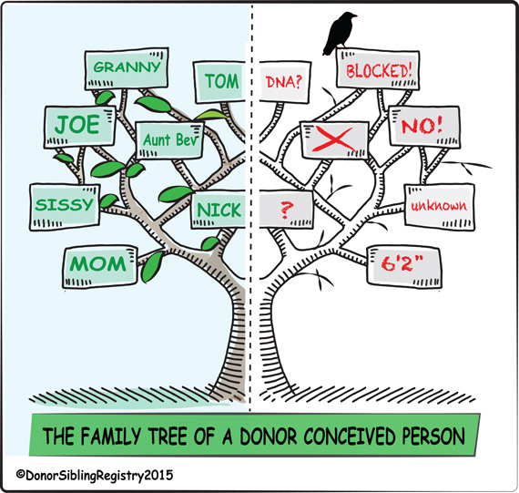
Psychological effects of anonymity on offspring
The psychological effects of donor anonymity on donor-conceived people include the following:
Wondering where they got some of their physical characteristics
Wondering where they got their talents and personality traits
Curiosity about genetic family history and ancestry
A longing to know and/or connect with their unknown genetic parent and other close relatives
Donor-conceived people desire to
know more about themselves,
find connections, and fill in
the missing pieces.
Notes:
There is no psychological research that backs up
the practice of anonymity. Quite to the contrary,
There are many published papers showing how
anonymity is harmful to donor-conceived people.

Slide 9
Early Disclosure
Given the history of secrecy and stigma surrounding infertility and donor conception, it is hardly surprising that there is insufficient research on adults who are DC, in large part because most are unaware of their own status.
On a systems level, this also extends to DC individuals misreporting medical and family histories across healthcare settings.
While it’s generally recommended to inform children of their DC status when they are preverbal, so that it becomes a natural part of their personal stories, these recommendations are not uniformly implemented, however, and donor information is still typically kept anonymous in the clinics, thus perpetuating gaps and misinformation distributed on individual, family, and healthcare system levels.
Many parents are still held back by the shame of infertility, embarrassment, and the fear of telling. Consequently, many older DC people are finding out as adults, either from their parents, other family members, found documents or DNA testing.
Notes:
The majority of the children of the 108 Egg Donor Parents and many of the 1700 sperm donor recipients are too young to have expressed curiosity yet and still the great majority of all offspring wish to be in contact with their donors and half siblings and recommend that parents use open or willing-to-be known donors.
Offspring of single heterosexual parents and LGBT parents learn about the method of their conception at an earlier age and are therefore more comfortable expressing curiosity about the donor with their parents than offspring of 2 heterosexual parents.

Slide 10
Implications for Healthcare
Medical issues can be a big problem in donor-conceived populations.
No regulation regarding comprehensive genetic and medical testing for donors, no tracking or limiting the number of offspring, and no universal standards for updating/sharing medical information amongst donor families.
More than ¾ of surveyed offspring were searching for their donors to learn more bout their medical history.
84% of sperm donors have never been contacted by their clinic(s) for medical updates.
23% of sperm donors felt that they or close family members had medical/genetic issues that would be important to share with families.
97% of egg donors have never been contacted by their clinic(s) for medical updates.
31% of egg donors felt they or close family members had medical/genetic issues that would be important to share with families.

Slide 11
Implications for Mental Healthcare
ALL psychologists are increasingly likely to encounter DC adults who discover their origins through DNA testing or similar means. This may be their primary reason for treatment, or they may be seeking services for unrelated reasons, and discover this during the course of assessment or treatment.
Mental healthcare systems have responded well to address the needs of infertile, single, and same-sex parent(s).
As such, there are numerous instances of DC individuals who have already received poor guidance from uninformed clinicians
Notes:
This may be their primary reason for treatment, or they may be seeking services for unrelated reasons, and discover this during the course of assessment or treatment.
But they have have much less preparation to manage the needs of the DC offspring, particularly those who learn of their origins as adults.
Which can significantly compound the impact of such a discovery.
2.

Slide 12
Implications for Psychotherapy
Common Themes for
Donor-Conceived Adults:
being lied to by the people they trust the most,
having their worlds and identities “turned upside down,”
Experiencing a lack of parental support and/or a feeling of betrayal from parents when wanting to learn more about their biological identities,
Having curiosity about and establishing relationships with biological parents (donors) and half-siblings,
Having curiosity about medical history,
Feeling frustrated with the lack of available information
having feelings such as anger, confusion, relief, curiosity, and sadness
Being overwhelmed by finding 20, 50 or more than 100 half siblings
and ultimately…needing to find a deeper understanding of forgiveness.

Slide 13
Current Research
Current research shows that donor-conceived people fare much better when told early on, even before they can remember, while late late disclosure can be quite difficult for many to process.
Many DC individuals have a great appreciation of not only their very existence and their lives because of the efforts it took for them to be conceived, but also a profound respect for their parents who demonstrated much determination and sacrifice towards these efforts, including the secrecy that followed for decades.
Some feel that they were very wanted children, and understand that the prolonged secrecy their parents lived with was an attempt to protect them from trauma.
Many struggle with anger and confusion and feel a sense of betrayal that they were lied to about something so core to their identity.
Notes:
Donors can define these connections in many ways. From becoming a “dad” to a simple anonymous exchange of medical information.
And, it’s not just about the donor, it’s about his family too.

Slide 14
Current Advice
.
Because current research shows that late discovery [i.e., adult] donor-conceived people report feelings of betrayal, loss of trust, and difficulty forgiving in relation to the late discovery experience:
Clinicians should therefore be prepared to work with these themes and associated distress in treatment. Forgiveness and empathy are key components in moving forward.
Address the systemic nature of family secrets and how clarifying these dynamics within a particular family can assist in the therapeutic process.
Notes:
Donors can define these connections in many ways. From becoming a “dad” to a simple anonymous exchange of medical information.
And, it’s not just about the donor, it’s about his family too.

Slide 15
New Donor Family Relationships
If the individual leans of his/her origins through a DNA website, confronting the family who raised him/her about this discovery can be extremely delicate, contingent on the level of shame and secrecy within the family.
Further, if the family system doesn’t support the curiosity that the adult DC person may have about his/her origins, the individual may perceive these feelings as a betrayal to his/her family, which may extend to reluctance to meet new biological relatives from the donor’s side(s), and/or ongoing shame and secrecy about his/her origins.
If the individual does choose to form these relationships, it can be overwhelming to navigate the complexities of large and ever-growing sibling cohorts and continually updated medical information, especially if this discovery was unanticipated.
These sibling relationships can be very rewarding as the individual redefines him/herself and his/her concept of “family,” yet they may also be kept secret contingent on the levels of individual and family shame across the members. Ultimately, our definition of family will need to be expanded to accommodate these new kinds of family systems.
Donors can define these connections in many ways. From becoming a “dad” to a simple anonymous exchange of medical information. And… it’s not just about the donor, it’s about his family too.
Notes:
Donors can define these connections in many ways. From becoming a “dad” to a simple anonymous exchange of medical information.
And, it’s not just about the donor, it’s about his family too.

Slide 16
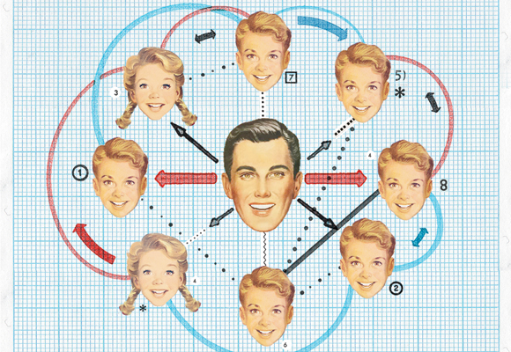
Donor Sibling Registry:
Educate, Connect, and Support Donor Families
69,500 Donors,
Parents, and Offspring
in 105 Countries
DSR: 2000-2020
19,100
People Matched!

Slide 17
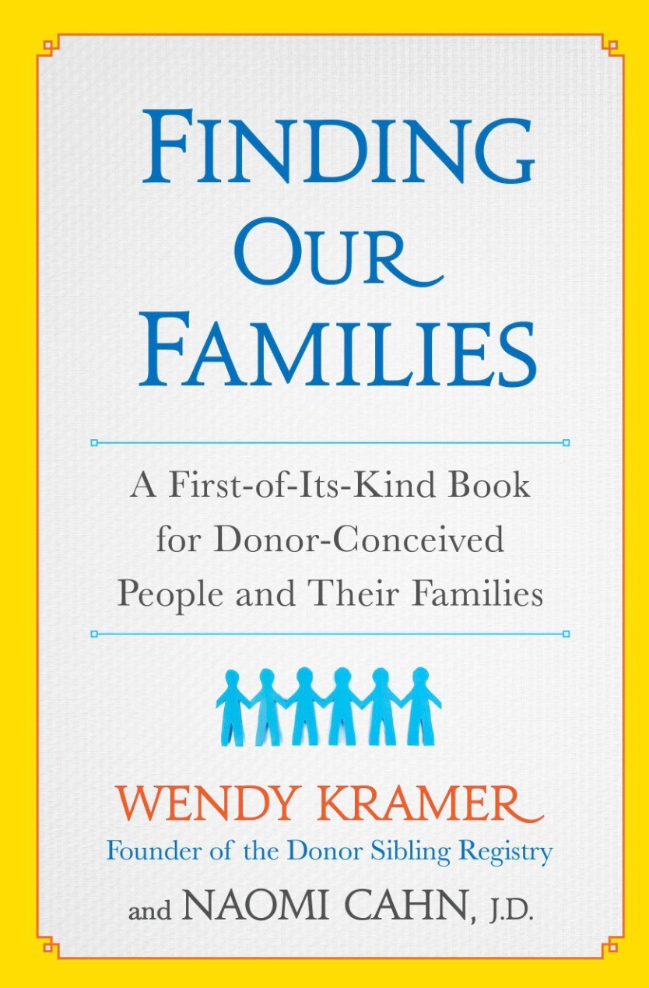
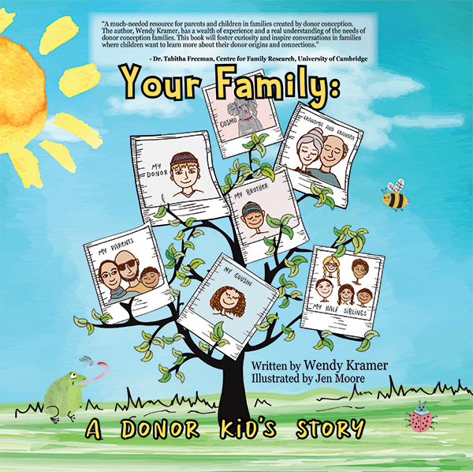
Books
Finding Our Families: A First-Of-Its-Kind Book For Donor-Conceived People and Their Families
If you are thinking about having a baby through donor conception, this book is for you. If you are a donor conceived person, this book is for you. If you are a parent raising a child who came to you through the help of an egg or sperm donor, this book is for you. If you are a medical or mental health professional, helping people build their families through donor conception, this book is for you…-Ellen Sarasohn Glazer LICSW, Co-Author, “Having Your Baby Through Egg Donation”
"Wendy Kramer tells an absolutely riveting story that only she could tell — one that documents a profound shift in the way we negotiate our biology ... and each other. Donor Family Matters captures what Kramer calls the 'difficult, messy, joyful, and rewarding endeavor' of raising a family in a way that will break your heart and then put it back together again." — Misha Angrist, Ph.D., author of Here is a Human Being: At the Dawn of Personal Genomics
"A much-needed resource for parents and children in families created by donor conception. The author, Wendy Kramer, has a wealth of experience and a real understanding of the needs of donor conception families. This book will foster curiosity and inspire conversations in families where children want to learn more about their donor origins and connections." — Dr. Tabitha Freeman, Centre for Family Research, University of Cambridge
Your Family: A Donor Kid’s Story

