Slide 1
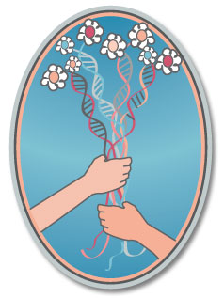

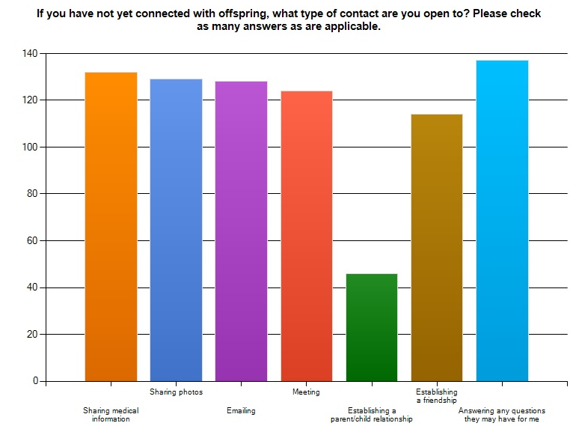
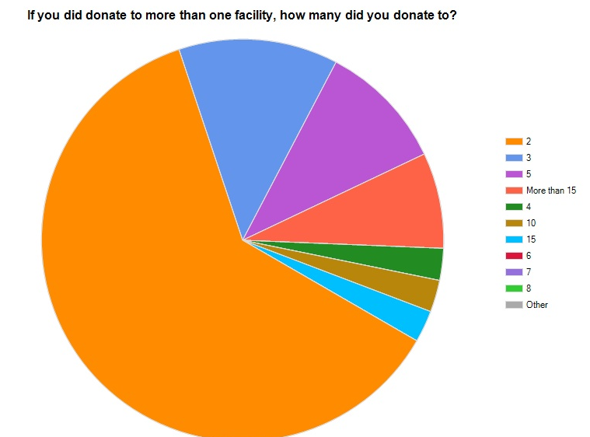

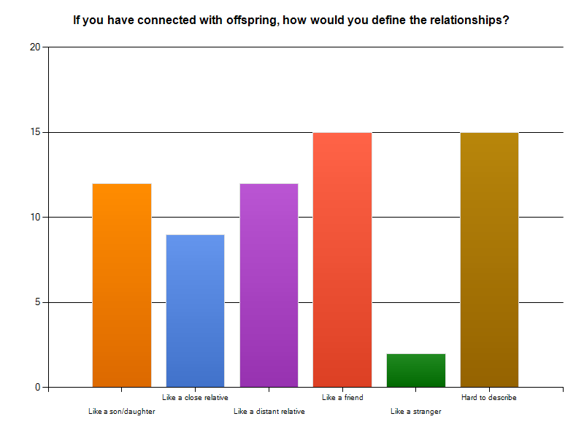
SEMEN DONORS WHO ARE OPEN TO CONTACT WITH THEIR OFFSPRING
Wendy Kramer*, Ken Daniels**, Maria Perez y Perez **
* Donor Sibling Registry, USA ** University of Canterbury, New Zealand
OPTIONAL
LOGO HERE
OPTIONAL
LOGO HERE
Objective
Recruitment, Motivations and Patterns of Donating
Contact with Offspring
Changing Views Over Time/Advice
Conclusions
65% were recruited by sperm bank advertisements, 28% by a friend, 7% by a professor and 9% by a doctor.
78% donated to help families, 61% for the money and 41% to pass on their genes.
Average length of donations was 2 years.
21% donated to more than one clinic.
35% were told by clinics that the number of children born from their donations would be limited.
97% said that they thought about the offspring they had helped create and 94% said they were open to connecting with their offspring.
79% had not yet connected with offspring.
Donors report that their feelings about donating have changed over time with the predominant theme being that they now realise donating semen was much more than a financial transaction.
When asked if their feelings had changed since donating, the following are a few of the replies:
“Yes. The future impact on the donor conceived children and my current family.”
“I was sure I wouldn't ever want to have contact with my offspring generated through donation, but as my wife neared the age where we'd have no more children, I started wanting to find out about other children I might have had.”
“Yes... I take it more seriously now. I have grave reservations about how poorly the industry is regulated.”
Some advice provided by donors:
“You are involved in the creation of real people, not an abstract concept. They will live and breathe and grow, and they will want to know about you. Be ready to have a big heart.”
“Get sufficient genetic testing and counseling to assure everyone involved that you are a safe, healthy source of donor semen. Insist on an open donor contract where the children will be provided with your basic information no later than age 18. Always consider abruptly stopping your donor career if a medical issue arises.”
The changing culture of gamete donation is impacting on all of the involved parties. Importantly, this study reports that semen donors are overwhelmingly open to contact/connection with their offspring and this result challenges the traditional view that donors wish to remain anonymous. Further, the issue of genetic testing and the sharing of medical information/history with donor offspring by donors has increased in significance within the donor anonymity debate. Interestingly, donors in this survey indicated that given the opportunity, they would be open to be genetically tested at the time of donation. Moreover, the fact that more than 80% of donors say that they never received any education or counseling on the potential curiosities of donor conceived people, clearly a better system of educating and counseling donor needs to be implemented.
The culture of gamete donation is undergoing a revolution. The previous practice of parents being secretive about their use of donated sperm, along with the accompanying anonymity of donors is changing and this has lead to more offspring being aware of their family building history. This in turn has lead to increasing numbers of offspring wanting to know or know about their biological father, his medical history and their ancestry. What does this mean for the donors, particularly those who were recruited on the basis of their being anonymous? How do donors view/understand their relationships with their families and their donor offspring? How has this changed since the time of their donations? And, what advice do donors have for those considering donating their sperm?
Surveys
The Donor Sibling Registry (DSR) conducted an online survey for semen donors and recruited through website emails and postings. The 45 question survey included multiple choice, open ended items and covered recruitment, motivations and patterns of donating, the donor and his family, contact with offspring, changing views over time and medical/health issues.
About the Donor Sibling Registry
Medical/Health Issues
The Donor Sibling Registry (DSR) is a non-profit, worldwide organization dedicated to educating, connecting and supporting donors, recipients and offspring. With almost 30,000 members, the DSR has helped to connect more than 8,000 half siblings and/or donors with each other.
Research has suggested that increasing numbers of donor offspring want to know about their biological father’s medical history and their ancestry. In this way, it is important for donors to have the ability to update and share medical and genetic information with their offspring.
70% said they never received genetic analysis by the clinic, while 93% said they would be open to such testing if it had been offered.
96% feel they were accurate with the medical information they gave at the time of donation, but 84% have never been contacted to update their medical history.
23% say that they or close family relatives do have health concerns or genetic risk factors that they have learned of since donating that would be important for recipient families to know about. 14% have tried to notify sperm banks of these issues.
Respondents
The Donor and His Family
The results reported in this presentation relate to 164 former donors (76% from the USA) who now say they are willing to have contact with the offspring they helped to create.
73.1% were DSR members.
26.9% were not actively seeking connection on the DSR.
Ages: 12% were under 35, 70% between 36-55 and
18% were over 55.
71% of donors were currently married or partnered and of these 91% had told their partner and 85% of the partners were open to connecting with the offspring.
58% of donors had children of their own and of these 38% know that their father has been a donor. A further 40% are too young to tell, and of these 85% will be told. 70% of children who knew about sperm donations were interested in meeting half siblings.
Contact information
Donor Sibling Registry PO Box 1571 Nederland Colorado US 303-258-0902 www.donorsiblingregistry.com

